Slide 1



Sunshine Realty Group
View in Power BI
Last data refresh:
8/2/2021 8:20:25 PM UTC
Downloaded at:
8/2/2021 8:24:10 PM UTC

Slide 2
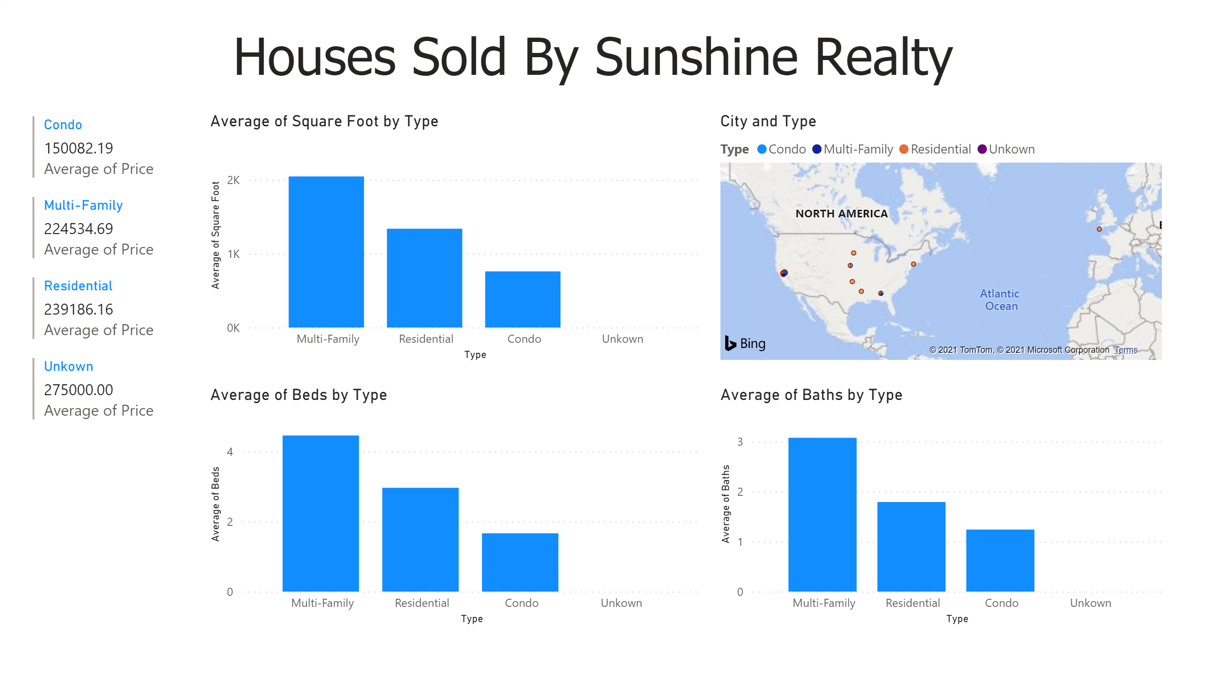
Page 1
Notes:
multiRowCard
No alt text provided.
clusteredColumnChart
No alt text provided.
map
No alt text provided.
clusteredColumnChart
No alt text provided.
clusteredColumnChart
No alt text provided.
textbox
No alt text provided.

